Slide 1
Sentimental Analysis in Text Mining
Guided by:
Ms. R.S. Ramya, AP/CSE

Slide 2
Table of Contents
INTRODUCTION
SYSTEM DESCRIPTION
LITERAUTRE SURVEY
MODULE
EXISTING SYSTEM
RESULTS
PROPOSED SYSTEM
CONCLUSION
SYSTEM ARCHITECTURE

Slide 3
Introduction
Sentimental analysis is a technique that detects the underlying sentiment in a piece of text.
It is a process of classifying text as either positive, negative, or neutral.

Slide 4
Literature Survey
GENERAL NEWS
Machine Learning Framework for the Detection of Mental Stress at
Multiple Level.
Mental Health Prediction Using Machine Learning: Taxonomy, Applications, and Challenges.
Sentiment Analysis of Text Documents. Sentiment Analysis using Text Summarization.
Text Summarization and Sentiment Analysis: Novel Approach.

Slide 5
Existing System
The main shortcoming of the Existing system was, it was a not an implemented model of the topic.
It briefly discuss about the various aspects of the Sentimental Analysis but it was used by various algorithms for classification.
Larger Dataset was needed to implement this existing system
(in millions).
03 / 12

Slide 6
Proposed System
GENERAL NEWS
In this system, an input text is read from the Colab and the model analyse the keyword present in it, and predict the output.
Extracting the keywords from the input text, classification, and predicting the output are done by Algorithms of Machine Learning.

Slide 7

SYSTEM ARCHITECTURE

Slide 8
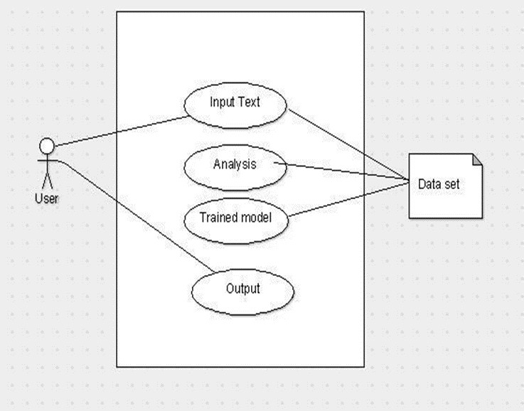
Use Case
A use case diagram is a dynamic or behavior diagram in UML.
Use case diagrams model the functionality of a system using actors and use cases.

Slide 9
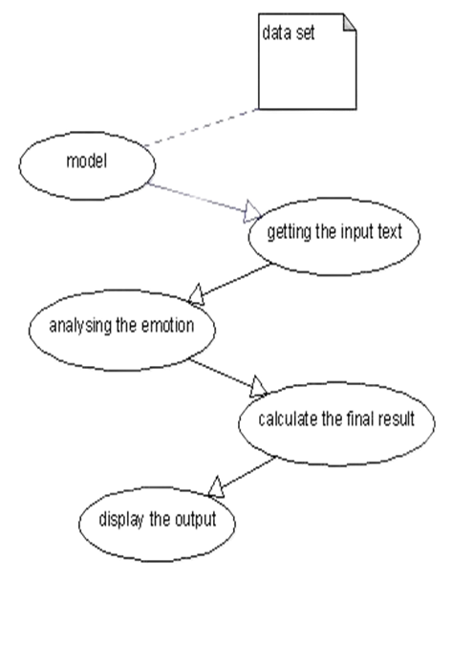
Data Flow
Dataflow is often defined using a model or diagram .
The entire process of data movement is mapped as it passes from one component to the next within a program.

Slide 10
System Description
Google Colabaratory
Dataset

Slide 11
Libraries Used
Pandas
Seaborn
Sci-Kit Learn
Numpy
Textblob
Wordcloud
Matplotlib
Neattext
Joblib

Slide 12
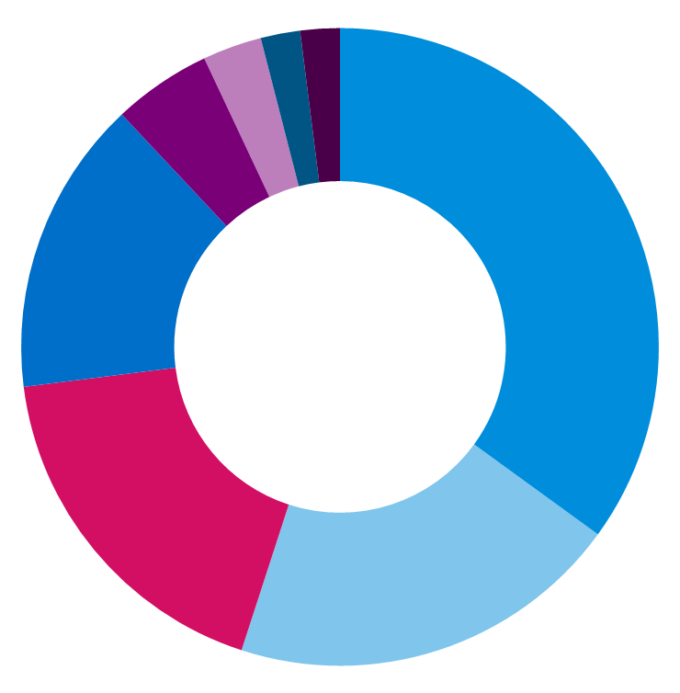
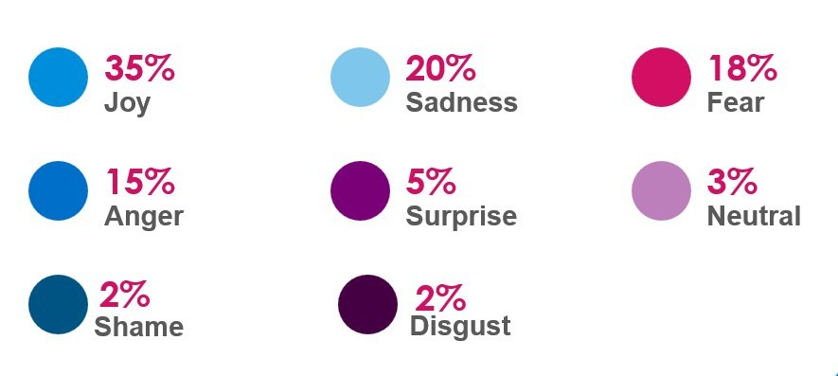
The chartslide represents Emotions which are included in our Dataset.
Chart Slide

Slide 13

Modules Description
Input Text
GENERAL NEWS
Text Enhancement
Extraction of Keywords Analyzing the Result Displaying the Result

Slide 14
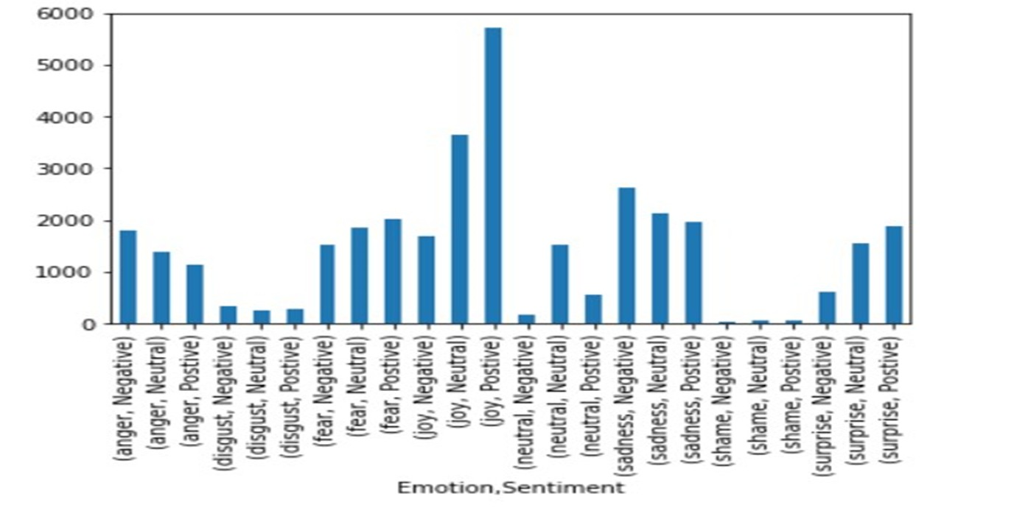
Matplot Representation

Slide 15
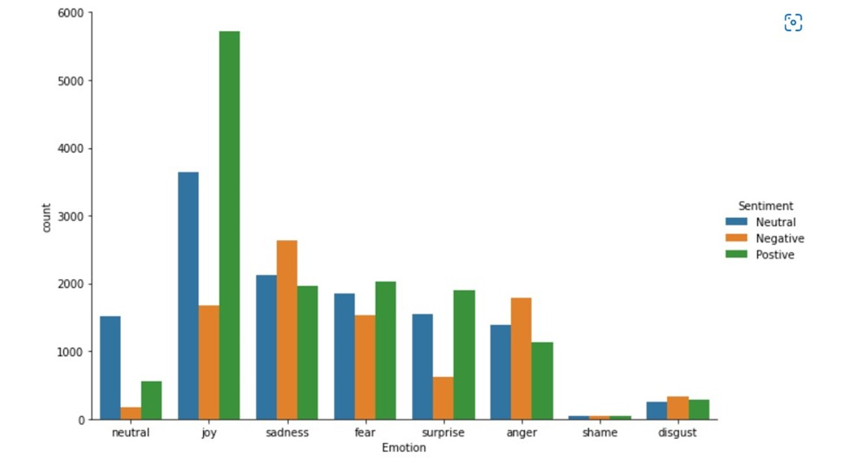
Matplot Representation

Slide 16
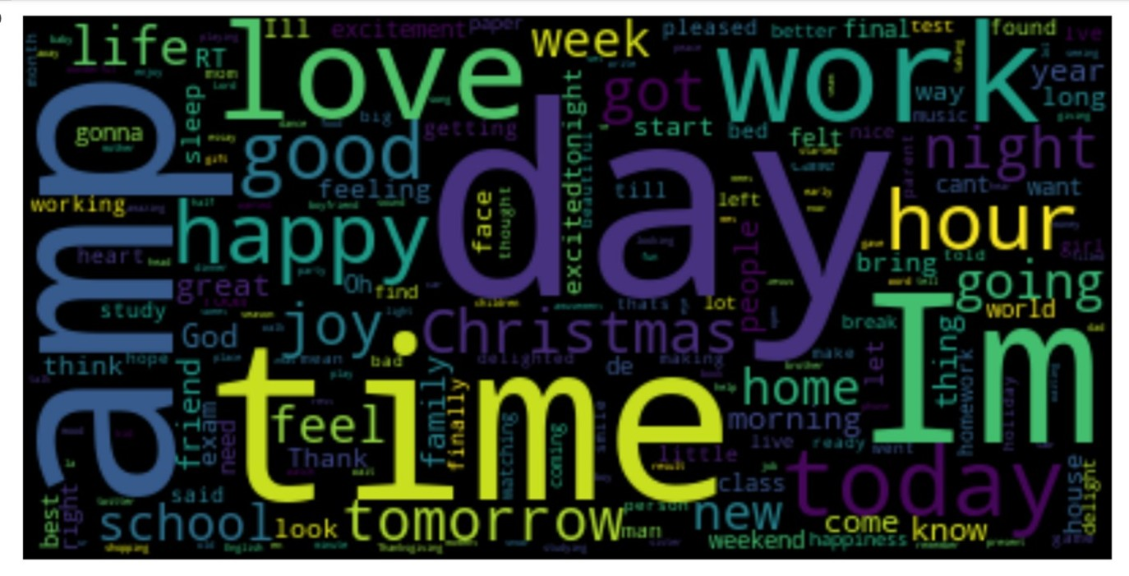
Wordcloud for Joy

Slide 17
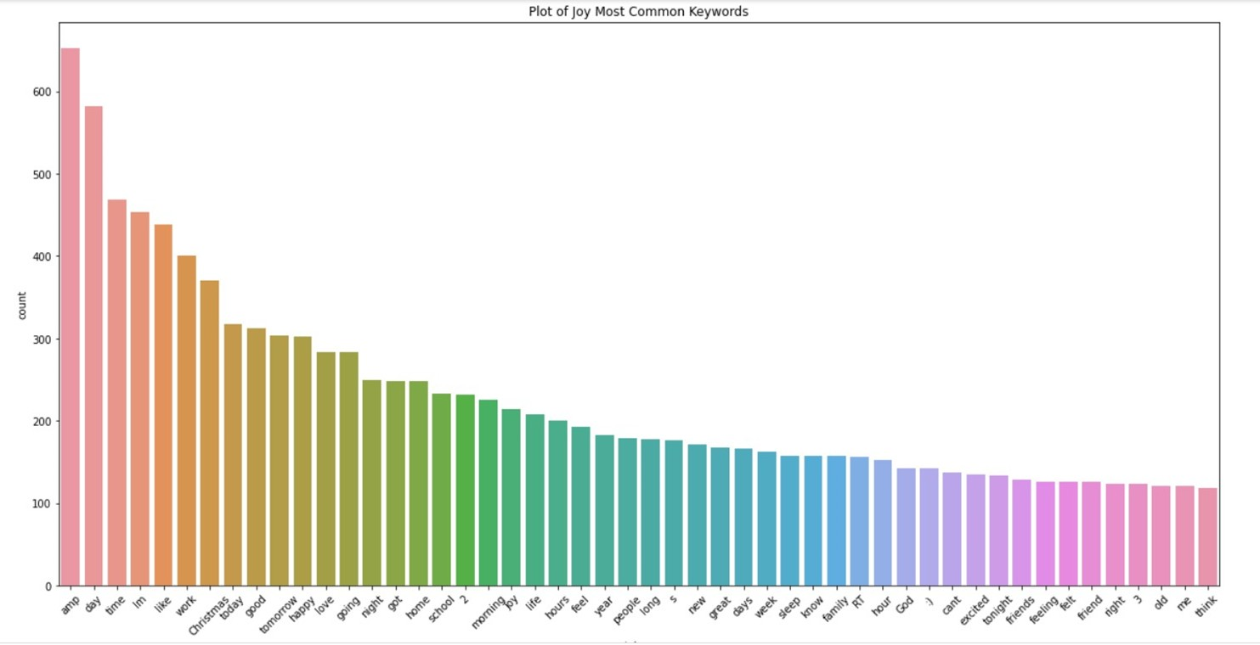
Seaborn for Joy

Slide 18
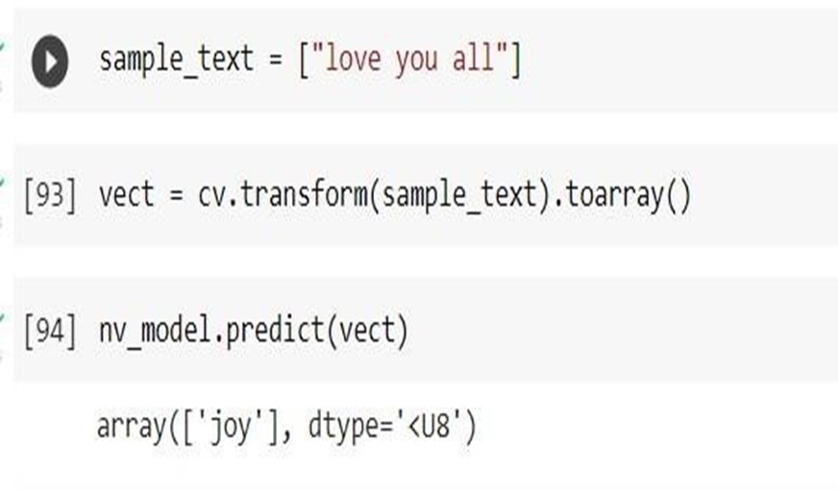
Output Sample

Slide 19
Performance and Evaluation
GENERAL NEWS
In this project, We achieved a successful implementation, of analyzing the Emotion of Text.
We can achieve 90% accuracy as of right now.

Slide 20
Conclusion and Future Work
GENERAL NEWS
In this project, We achieved a successful implementation of predicting the emotion of a text.
we can take up to 100% if we add more no. data's(in millions if possible) to the dataset and predict the emotion of the text accurately.

Slide 21
Our Team
DAWOOD IBRAHIM
GANESH KUMAR
SIVASAMY
SUBBUKUTTY

